Slide 1

Google App Store Reviews
ITC6008A1 - SEARCH ENGINES AND WEB MINING
Alkiviadis Kariotis - 241735
Celsa Ameida - 267628
Giorgos Aliferis - 272183
Margaritis Konstantinos - 271868

Slide 2
Table of Contents
Phase 3
Phase 2
Phase 1
Sentiment-analysis
Final IR system
Recommendation System
Clustering
Topic Modeling
Word to Vec
Summarization – Bart
QA system
Sentiment
Web Scraping
Data Collection and preprocessing
IR system

Slide 3
Web Scraping and Data Preprocessing
01

Slide 4
Data preprocessing and cleaning
Web scraping
Indexing and Retrieval
The outcome of our scrape returned 26 apps.
Then we downloaded the 200 most recent and relevant reviews for those apps for each rating in order to have a balanced dataset.
We stored those reviews in a dataframe and we performed NLP techniques such as lowercasing, remove stopwords and characters, lemmatizing and tokenizing
Then we created an inverted and a positional index
We used the Google Play store library to reach out the most relevant Social Media Apps based the query search of “Social Media” in Greece

Slide 5
Positional Index
Great
Review Example before preprocessed
Review 0: “Snapchat was a great app. But after so many updates it only seems to get worse. Is the AI feature and getting notiﬁcations when someone is typing really that necessary?”
Review Example after being processed
Review 0 : snapchat great app updat wors ai featur get notif type realli necessari
Index 0
Index 26
Index 41
Inverted Index
Great
Index 0 position 0
Index 26 position 12
Index 41 position 41

Slide 6
Boolean Retrieval
Great
0
4079
8194
8204
Love
4
4079
20489
8204
Great AND Love
4079
8204
Great OR Love
0
4079
8194
8204
4
20489

Slide 7
TF-IDF
Through the use of TF-IDF (Term Frequency-Inverse Document Frequency) analysis, we have effectively quantiﬁed the signiﬁcance of individual terms or words within each document, relative to the entire collection of documents, known as the corpus.
This approach has allowed us to create a sparse matrix that captures the unique importance of terms within speciﬁc documents.

Slide 8
02
Sentiment Analysis
Final IR system
Recommendation System
Clustering
LDA and Topic Modeling

Slide 9
Sentiment Analysis
We used TextBlob library which has been built on top of Ntlk to perform sentiment analysis. The results we
get seems to capture the emotion in most of the cases
Snaptchat APP Positive: Love app update
Neutral : camera wont orient upright
Negative: There’s a very annoying bug,
please ﬁx it

Slide 10
Final Query processing
and IRS
We used the inverted and the positional index from the ﬁrst step
We proceeded with utilizing the TﬁdfVectorizer in order to transform the contents of our reviews into a TF-IDF matrix
We tried to enhance our query effectiveness through designing a simpliﬁed query whose
purpose would be to add extra synonyms to the original query
We also developed a Boolean search approach

Slide 11
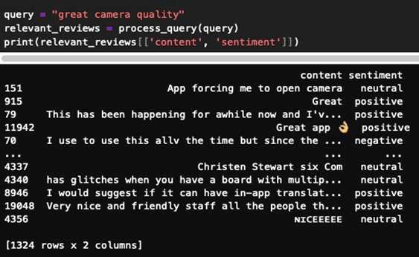
Final Query processing
and IRS
After those steps, the documents are ranked based on how relevant they are with the query, which is calculated
through the computation of the cosine similarity between the vector of the inserted query and the
documents one’s in the TF-IDF matrix.

Slide 12
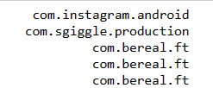
Recommendation System
Our recommendation system that we build receives a user query as input and then calculates the similarity between the input provided and the term frequency inverse document frequency vector representation of the user reviews from our main data frame.
Starts by firstly transforming the natural language text input query into a vector, then makes the comparison, and then returning the top five apps with the highest cosine similarities scores.
So, given the input “Camera quality” the results we get are the following ones

Slide 13
Clustering
We proceeded with the clustering machine learning technique. The scope of this is to group together similar data points and assign them to the so-called clusters based on common similarities or features found in the dataset
So, we created ﬁve clusters through the use of the K-Means model and applied the ﬁt_predict method on the TD-IDF matrix, in order to assign each review to its respective cluster

Slide 14
LDA and Topic Extraction
We imported and speciﬁed the aforementioned model, ﬁtting it into the TF-IDF matrix which has been created in the earlier steps and is representative for the entire corpus of the reviews of the users collected.
The code then proceeds with identifying for each associated topic the most signiﬁcant words, and then through the LDA model we are able to specify the number of the top words must that we need to extract from every topic that we are dealing with.

Slide 15
03
Word Embeddings
Summarization
Question-Answering System

Slide 16
Word Embeddings
We used Word2Vec technique by assigning each one of the unique words of the entire corpus to a speciﬁc corresponding vector from the space, positioning their vectors in such a way so that they share common context regarding the corpus and they are located close to another inside the space

Slide 17

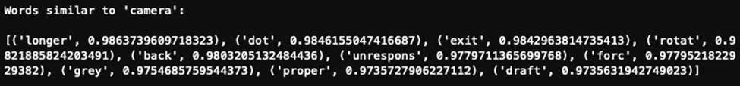
Word Embeddings
So, we applied the technique on the reviews with vectors of 100 size, meaning that each of the word given would be a one-hundred-dimensional vector, with window size set to 5 and min count set to 1 which states that even words will be included only once in the model.
Here are some results of the application of the Word Embeddings:

Slide 18
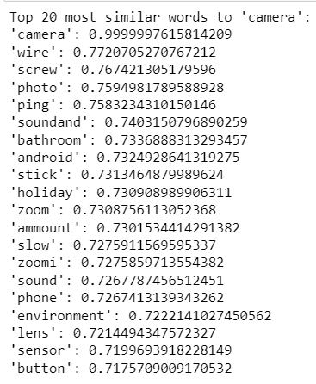
Extracting Useful Info: Zero –Shot Inference
We examine a subset of the scraped reviews viz. Snapshot app
A user usually scrolls through the reviews. Querying or summarizing may shorten the process
Simple word similarity with BERT is not the way to go though considering it may be apples to oranges comparison
We try zero-shot Summarization via Hugging Face:
facebook/bart-large-cnn
User can read just the summary ! :

Slide 19
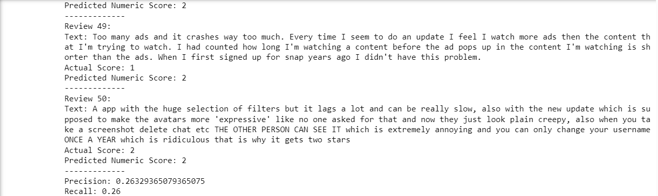
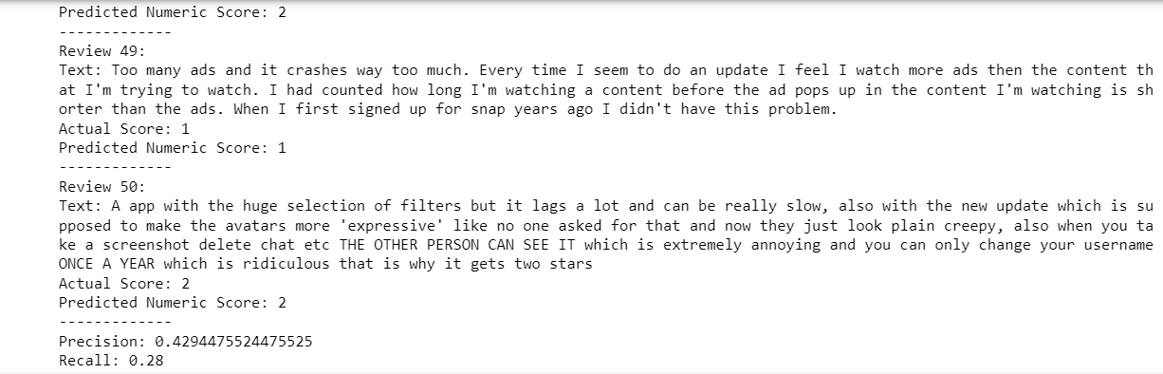
Can We Compare Fresh Reviews and Auto-rate them? (Zero –Shot Inference Cont’d)
We check metrics of HuggingFace models with our dataset with 50 randomly selected reviews
bert-base-multilingual-uncased-sentiment
LiYuan/amazon-review-sentiment-analysis
Precision slightly improves : we could attempt more fine-tuning

Slide 20


Issues with fine-tuning Bert Models in Our Dataset
We attempted fine-tuning of this model on our dataset, but the attempt is not successful since training accuracy is low and slightly decreases over each epoch .​
This dataset may be not suitable for this type of model or may need specific adjustments for the training, test , validation split which may be explored in the future.​
We tried with subset of Snapchat reviews ​and the Whole Dataset.

Slide 21
Harnessing Q&A models: If User would like to make Specific Queries
We use models benchmarked on SQuAD and SQuAD 2
Query 1- 'Does snapchat have issues for sharing photos with friends?
distilbert-base-cased-distilled-squad
roberta-base-squad2
Query 2- camera quality
distilbert-base-cased-distilled-squad
roberta-base-squad2

Slide 22
Thank You

